Slide 1

Introduction to IT Project Management and Entrepreneurship
Lecture 2
Deepak Chandra Roy
Adjunct Faculty, CSE, EWU
deepak.kth@gmail.com
01685441156

Slide 2
Agenda
Overview of Today's Class
Recap of lecture 1
Project Initiation
Next Class >> Project Presentation
& Project Planning in IT

Slide 3
Recap of Lecture 1
The key points covered in Class 1:
Introduction to the Course
Key Concepts (IT Project Management and Entrepreneurship)
Role of IT in Entrepreneurship
Importance of the Course

Slide 4
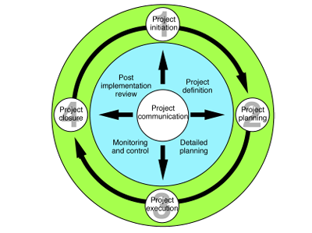
Project Life Cycle (PLC)
The project manager and project team have one shared goal: to carry out the work of the project for the purpose of meeting the project's objectives. Every project has beginnings, a middle period during which activities move the project toward completion, and an ending (either successful or unsuccessful).
A standard project typically has the following four major phases (each with its own agenda of tasks and issues):
initiation,
Planning
execution
closure.
Taken together, these phases represent the path a project takes from the beginning to its end and are generally referred to as the project life cycle.
Figure: The four phase of the project life cycle.
Adapted from J. Westland, The Project Management
Lifecycle, Kogan Page Limited (2006).

Slide 5
Five Interacting Processes Make up a Project
Initiation: authorizing the project
Planning: defining and refining objectives and selecting the best of the alternative courses of action.
Execution: coordinating the people and other resources to carry out the plan
Controlling & Monitoring: ensuring that project objectives are met by monitoring and measuring progress to identify variances from the plan so that corrective action can be taken
Closure: formalizing acceptance of the project and bringing it to an orderly end

Slide 6
Project Initiation

Slide 7
Project Initiation
In the initiation phase, the project objective or need is identified; this can be a business problem or opportunity.
An appropriate response to the need is documented in a business case with recommended solution options.
A feasibility study is conducted to investigate whether each option addresses the project objective and a recommended solution is determined.
Issues of feasibility (can we do the project?) and justification (should we do the project?) are addressed.
Once the recommended solution is approved, a project is initiated to deliver the approved solution and a project manager is appointed.
The major deliverables and the participating work groups are identified and the project team begins to take shape.
Approval is then sought by the project manager to move on the detailed planning phase.

Slide 8
Who are they?
Entrepreneur
Senior Management
Project Manager

Slide 9
Role of Entrepreneurs
Entrepreneurs are typically the individuals or groups who conceive the initial idea for a project. They identify opportunities or needs in the market and come up with innovative solutions to address them.
Entrepreneurs are responsible for defining the overall vision and goals of the project. They set the strategic direction, decide on the project's objectives, and determine its feasibility.
Entrepreneurs often secure funding and resources for the project, whether through personal investment, venture capital, loans, or other means.
They are also responsible for the project's initial planning and may assemble a team of experts to help develop and execute the project.

Slide 10
Role of Senior Management
Entrepreneurs are not necessarily senior management in a traditional sense, but their role within an organization or startup often involves leadership and decision-making that is senior in nature. It's important to understand the distinction between entrepreneurs and senior management
Senior management consists of individuals who hold executive positions within an organization, such as the CEO, COO, CFO, and other top executives.
Senior managers are responsible for implementing the strategic vision set by the entrepreneur or company's board of directors. They oversee various functional areas of the company, such as operations, finance, marketing, and human resources.
They are typically responsible for day-to-day operations, making tactical decisions, and ensuring the organization operates efficiently and effectively.

Slide 11
Role of Senior Management Cont..
In many startups, especially in the early stages, the entrepreneur may serve as the de facto senior manager, making strategic and operational decisions.
As the company grows, it is common for entrepreneurs to bring in experienced senior managers or executives to handle day-to-day operations, while the entrepreneur retains a strategic and visionary role.
In established organizations, senior management is usually a distinct layer of leadership separate from the founders or entrepreneurs.

Slide 12
Senior Management
“Senior Management” are your bosses
Program managers
Division heads
Vice presidents
Managing partners
It is important to remember that the structure and culture of the organization affect the project manager’s relations with senior management. Relations may be very formal and hierarchical, very informal, or somewhere in between.

Slide 13
Understand Senior Management’s Role
They have authority and power
Usually, they select and initiate projects
As a project manager, ask yourself –
What do they need from me?
What do I need from them?
Once the project has been approved by senior management, the project manager must continue to work with senior management and keep them informed of the project’s progress. Senior management’s role in the project is that of support, not implementation.

Slide 14
Role of Project Manager
Project managers are individuals responsible for planning, executing, and overseeing the day-to-day operations of a project.
They take the entrepreneur's vision and objectives and translate them into actionable plans. This includes defining the project scope, schedule, budget, and resources required.
Project managers are responsible for organizing and leading project teams, assigning tasks, and ensuring that work progresses according to the plan.
They monitor and control the project's progress, identifying and mitigating risks and issues, and making adjustments as necessary to keep the project on track.
Project managers also communicate with stakeholders, report on project status, and ensure that the project is completed within the established constraints.

Slide 15
Role of Project Manager Cont..
Why Projects Originate?
Product obsolescence
Competitive forces
Client requirements
Employee suggestions
Other sources
Although there are certainly exception to the rule, the project manager is not usually involved in this decision.
Nevertheless, the project manager should understand why the project is being launched in order to ensure that the result delivered meets the needs for which it was started.

Slide 16
Project Initiation Process
The project initiation process is the first phase in the project management life cycle. It involves defining the project's purpose, scope, objectives, and stakeholders, as well as securing initial approvals and resources to begin the project. The key steps in the project initiation process typically include:
Identify Project Goal and Objectives
Stakeholder Identification and Analysis
Feasibility Study
Project Team Assignment
Initial Budget and Resource Allocation
Risk Assessment
Project Approval
Project Kickoff Meeting
Project Charter Development

Slide 17
Defining Project Goals and Objectives
Discuss the importance of setting clear project goals and objectives.
Provide examples of project goals and objectives in IT and entrepreneurship contexts.

Slide 18
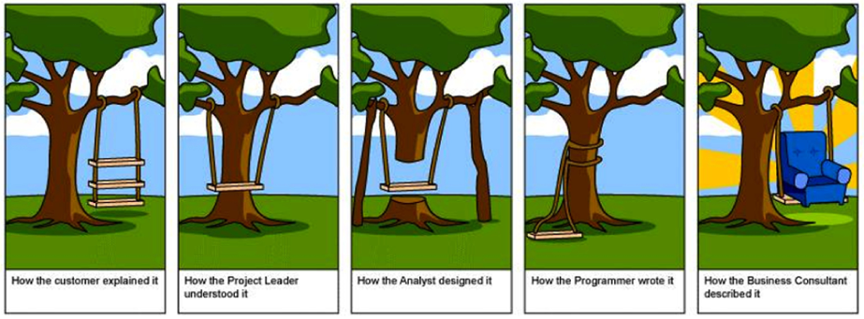
Importance of clear objectives

Slide 19
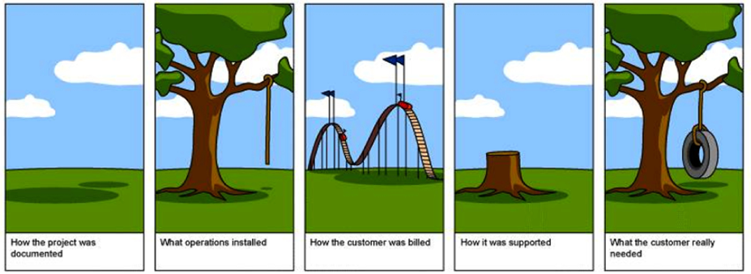
Importance of clear objectives cont..

Slide 20
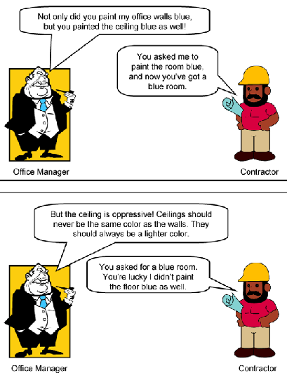
Importance of clear objectives cont..

Slide 21
Stakeholder Identification
Identify all individuals, groups, or organizations that have an interest in or may be affected by the project. These are known as stakeholders.
They play a vital role in the success of a project and can influence or be influenced by project outcomes. Understanding and managing stakeholders is a critical aspect of project management.

Slide 22
Stakeholder Identification Cont..
Types of Stakeholders:
Internal Stakeholders: These are individuals or groups within the organization where the project is taking place. They can include project sponsors, senior management, project team members, and employees.
External Stakeholders: These are individuals or groups outside the organization but have a vested interest in the project. They can include customers, suppliers, regulatory authorities, local communities, and the general public.

Slide 23
Stakeholder Influence and Impact
Stakeholders can have varying degrees of influence and impact on the project. Some stakeholders may have decision-making authority, while others may only be indirectly affected.
Understanding stakeholder influence helps project managers prioritize their communication and engagement strategies.

Slide 24
Stakeholder Communication and Engagement
Effective communication with stakeholders is essential. Project managers should establish a clear communication plan to keep stakeholders informed and engaged.
Regular updates, meetings, and feedback mechanisms are common tools for managing stakeholder relationships.

Slide 25
Stakeholder Conflict Resolution
Conflicts among stakeholders are common in projects, particularly when their interests or expectations diverge. Project managers must have strategies in place to address and resolve conflicts in a constructive manner.

Slide 26
Stakeholder Analysis
Stakeholder analysis involves identifying, assessing, and prioritizing stakeholders based on their influence, interest, and impact on the project. This analysis helps in tailoring communication and engagement strategies.

Slide 27
Project Charter :Introduction
Overview of the Project
Provide a simple but precise statement of the project.
Example
Rice University is planning to create a store to sell computer supplies
Purpose of the Project Charter
The Project Charter outlines the purpose, objectives, and scope of the project.
The purpose of a Project Charter is:
to provide an understanding of the project, the reason it is being conducted and its justication
to establish early on in the project the general scope
to establish the project manager and his or her authority level
A note of who will review and approve the Project Charter needs to be included.
Example
The Project Charter will be reviewed by the project team and approved. The final approval will be the Dean of Undergraduate Studies.

Slide 28
Project Charter : Project Objective and Scope
Objective
The objective of the project should clearly stated and contain a measure of how to assess whether they have been achieved. It should be realistic, and include the objectives. It should follow the SMART framework
Example
The objective of this project is to implement a campus store that is ready to sell computer supplies such as memory sticks, mouse pads, cables, etc. when class starts in August 2023, with enough inventory to last through the first two weeks of classes.

Slide 29
Project Charter : Project Objective and Scope Cont..
Scope
The scope of the project should be listed.
Example
The scope of the Rice's school supplies store project includes the activities listed below:
Determine what supplies will be sold in the store
Establish competitive prices for the computer supplies
Source and secure supply vendors
Establish marketing, procurement, operations and any other necessary departments, schools, centers and institutes.
It is equally important to include in the scope what is not included in the project.
Example
The scope of the project does not include:
Development of any other school store departments
Store design or construction

Slide 30
Project Charter : Milestones
Major Milestones
A list of the milestones that are needed.
Example
All vendors selected
Contracts or orders complete with all vendors
Supplies delivered to the store
Pricing determined.

Slide 31
Project Charter : Deliverables
Major Deliverables
Assumptions
The assumptions in creating the project are to be outlined
Example
Only computer supplies will be sold in the store.
Supplies customers will be the Rice University student body and faculty
Rice University students will manage the project and be responsible for ongoing operations.
A store sponsor from the University faculty or staff will be assigned to mentor students and to provide oversight.
Store hours of operation will be approved by the Rice University students or store sponsor.
Supply deliveries will be arranged or the store sponsor will pick them up with students.
Students will be empowered to contact vendors for order placement and inquiries via telephone.

Slide 32
Project Charter : Constraints
Constraints
It is important to define any and all constraints on the project or those working on the project
Example
Student availability to meet for project planning is limited to school hours.
The Rice University Student Association will be responsible for the creation and operation of the store.
Software is not available for project planning and control.

Slide 33
Project Charter : Business Need or Opportunity
Provide a concise statement of the business need or opportunity that led to the creation of the project.
Example
The goal of this project is to provide income for the Rice Student Center while supplying necessary items to students and faculty at competitive prices. The school store will be a convenience to students since necessary supplies will be available on campus. This will help students to learn to manage their personal supplies.

Slide 34
Project Charter : Preliminary Cost for the Project
A statement is to be provided indicating how the cost of the project will be defined and controlled.
Example
The procurement team will assemble a proposal based on expected costs for review by the Dean of Undergraduate Studies.

Slide 35
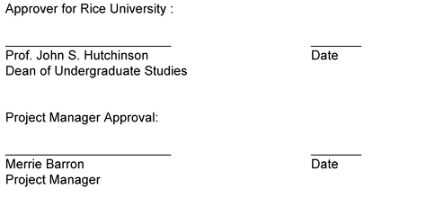
Project Charter : Project Charter Acceptance
The names, titles, and signature lines of the individuals who will sign-off on the Project Charter is provided
Example

Slide 36
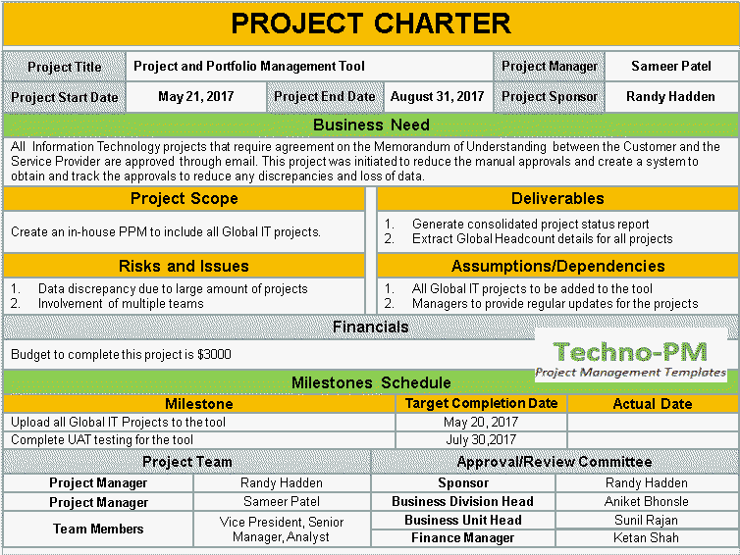
Project Charter Example

Slide 37
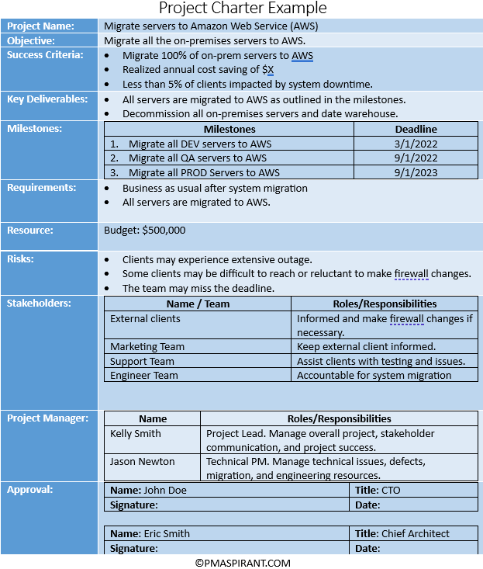

Slide 38
Q&A Session

